Slide 1
The Value of Relational Perspectives
Sravya Maduri, Stephanie Nawas, Swati Suman, and Wangyuan Zeng

Slide 2
Scenario (Background)
The scenario we are presenting is about Swati’s friend/colleague Ashima(alias).Personally,she is a very relational person.She had recently joined a game development company (start -up) as a senior technical engineer willing to take risks and explore new ideas in the field.She was the only female in the team.
Ashima’s first project was to develop a video game which was to be launched for the Asian markets in the first phase.The design of the game was first developed & approved by the system architect and then given to her for the implementation(coding). Ashima was leading the engineering team.The design provided to her was very good , however, Ashima was quite concerned , because in order to utilize the design to its full efficiency , it would need higher resolution graphic support.But majority of the customers in the developing countries do not own such high end mobile phones hence , the product compatibility might be an issue in these regions.Having come from the same environment (developing Asian country: India), Ashima was quite well aware of the situation.So, she presented to concerns to her manager .

Slide 3
Scenario
She also suggested some ideas and few changes to make it more suitable for the target users.Unfortunately, her concerns were not acknowledged.The manager seemed to completely ignore her concerns. She also tried to get in conversation with the design and marketing team as well, because she wanted to make sure there is no re-work after her team has already put in efforts for developing the whole system. Unfortunately, Ashima was advised to focus only on “her” job(i:e: to follow the design and develop the product) , and that the design team are well aware of how to do their job. This made Ashima feel very ignored and disrespected.
And finally she went ahead and developed the game as per the given design. Later , although the game did well in the US market , it was not as profitable in the Asian market. And the engineers had to make modifications and make it compatible with the user needs. Which was a waste of extra effort , time and finances.
Although my friend is in a different team now. But she still feels bad about the incident. I am not sure about the reason behind her treatment ., whether such ignorance was because of the gender bias or because of her being relational and the manager being individualistic

Slide 4
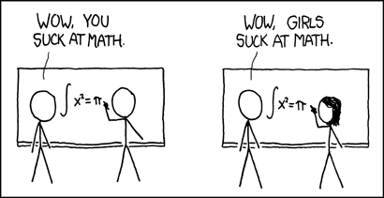

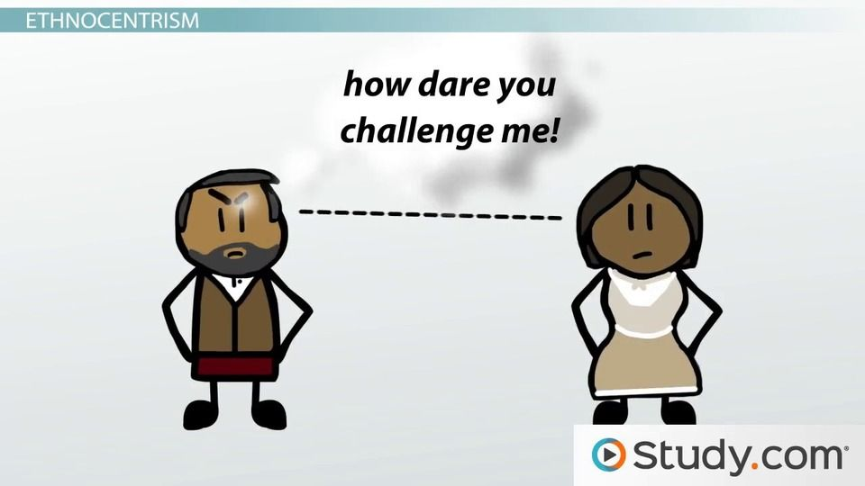
Analysis

Slide 5
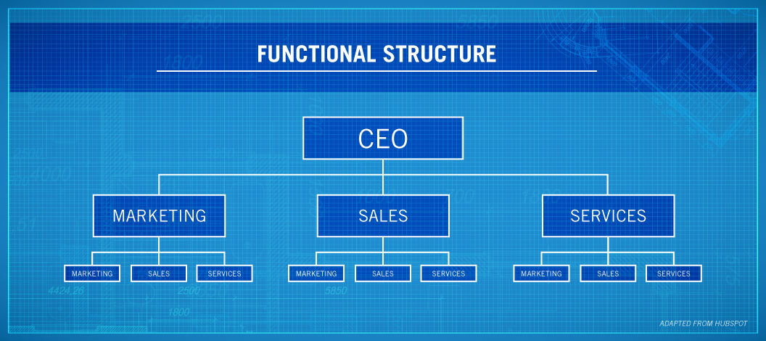
Company Structures
Relational people tend to consider multiple factors outside of their given task, while typical company structures expect employees to perform their assignments within their job descriptions only
In Ashima’s case, the management at her company refused to acknowledge her concerns about marketing and finance because of her technical role
Ashima was expected to simply follow instructions and have her team implement code she knew was not going to sell well in the long run
The company structure prevented her from leveraging her relational competency, and left Ashima feeling disheartened

Slide 6
Individualistic Management
Individualistic people tend to go with their own plans without considering the opinions or concerns of teammates.
In Ashima’s case, the management refused to acknowledge her concerns regarding the resolution of the game on different phones and told her to go along with the project anyway
Ashima interpreted this behavior as incredibly rude, even if it was not the intention of the managers to be malicious in any way
Although individualism can promote innovation, it can hinder cooperation. In the long run, this sometimes means productivity suffers and conflicts increase. Lack of productivity can decrease overall revenue, and conflicts may cost money to resolve. Individualism also can create a tense work environment if people are too rigid in their ideals.

Slide 7

Gender Bias
Another possibility for why Ashima’s concerns were ignored may be classical gender bias.
Especially as a technical leader, Ashima was in a very male-dominated environment.
Whether consciously or not, her coworkers may not have taken her as seriously due to the fact that she was a woman in a technical role.
On top of being brushed off, she was also one of the only women on her team, so this behavior left her feeling isolated and disrespected

Slide 8
Leadership Trust
Another interpretation of the situation can stem from the fact that Ashima was relatively new to the company at the time of the incident
Ashima may not have had enough time to build trust and rapport among her coworkers and demonstrate exemplary leadership skills and knowledge
When the managers brushed off her concerns, it may have come from skepticism of her competence as a leader or suspicion of her knowledge of the company’s products or vision.
Despite this, the incident left her feeling disheartened about her role in the company and she felt frustrated by the limitations despite her role as a leader

Slide 9
Possible Solutions

Slide 10

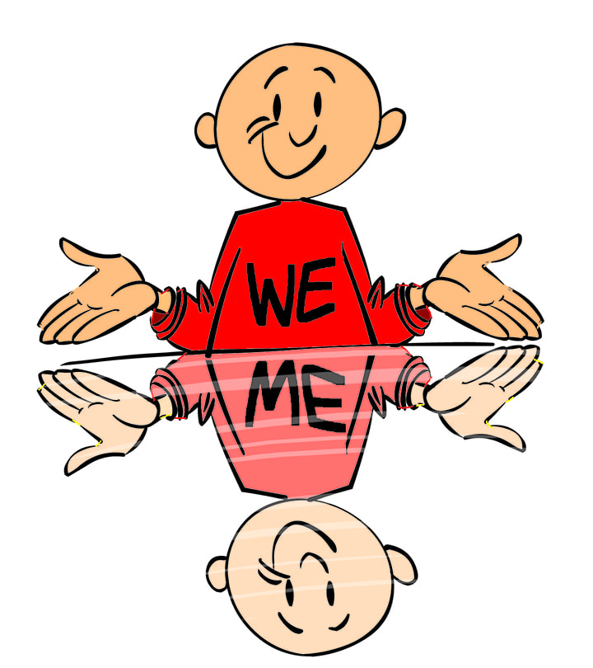
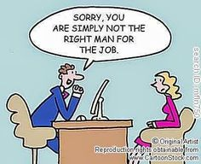

Slide 11

Analysis the situation
It is a common situation that one’s point of view is not taken by the manager. The key is to find the reason and trying to avoid it in the next time

Slide 12
Possible reasons
Fresh to in the team, I have not yet earn the trust from the manager.
Manager have their own ideas and are not easily persuaded by others.
Manager didn’t read my email by accident.
In the worst case, manager do have bias on female in the workplace.

Slide 13
How to solve this situation
Build reputation and win the trust from the manager.
Express your views to the leader in different ways to ensure that the manager could see it. Send your mail and cc to the skip manager just in case.
If confirm the manager do have bias on female, report to the HR and skip manager. Find another team as soon as possible.

Slide 14

At the time of suggesting ideas to her manager:
She could have conveyed her ideas by email, in
order to create a paper trail and by asking
neutral,non confrontational questions when
discussing it.
She could have developed at least one possible
solution that she can offer. Trying to support
her suggestions with data she may be able
to provide insights that her manager doesn't have. Whether or not the solution gets adopted, having a remedy at the ready will demonstrate her initiative, give her credibility, and allow her to move the conversation past the error to focus on putting things right.

Slide 15
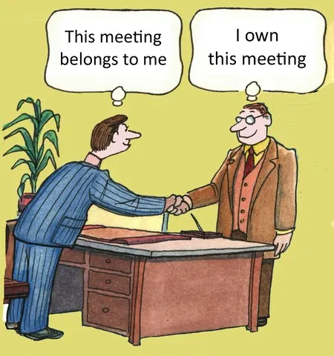
Dealing with individualistic manager:
Finding ways to navigate differences.
She could look for ways to reach him that are non-
invasive.
Being a Relational person,she could have issues
understanding her manager. But,the more she
tries to understand about his general
patterns(emotional,behavioral patterns,
preferences, idiosyncrasies), the more predictable the manager will become, and easier it usually is to deal with him.
Just keep it concise. Don’t waste their time with
waffling, know what the objective is, deliver it
and then get out of the way.

Slide 16
Being a fresher in the company:
Trust me no one would be keeping a list of your accomplishments, that’s your job. It is not their job to read your mind, even if it were possible. This applies to all situations in life, not just in the office.
If you are making progress on a project, let them know in your one-to-one. If you have come up against a hurdle or a difficult stakeholder who is not relenting, don’t wait tell your Boss as soon as is realistically possible, do not let this be a surprise they are ambushed with it in the hallway.
By applying these strategies, her work would become more visible to the manager and he might consider her idea.

Slide 17
Instead joining different team:
There may be several days in your career that seem like your resistance has been crushed and it’s time to take the attack to the opposition. This feud can carry on for months and can create an ugly atmosphere where you remain constantly frustrated and will make you think back to the times when you should have remained passive instead of defensive.
As the phrase goes — “I’m the boss and I make the rules”, there is no countering the fact that your boss will always hold more power than you. Unfortunately, even if you are right and your boss is wrong it’s necessary to remain silent and request for an opportunity to politely explain the situation without opposing the idea.
Being defensive can cost you valuable recommendation marks that could have potentially helped you in landing your next job. Avoid imposing language and stick to venting out your frustrations outside the office, your future self will thank you for enduring these difficult times.

Slide 18

Feeling as the only woman in her team:
“Instead of thinking of yourself as the only woman in the
room, be the first woman in the room”.
Replacing your only-woman-in-the-room thoughts
with “I’m the person my company hired to get this
work done” takes the irrelevant noise out of the
situation.We’ve all heard it before: men tend to
perceive women as unpredictable, irrational, and emotional. Of course, this isn’t true, but this negative perception of women permeates both our personal and professional lives and tends to make us back down from conflict in the workplace.
In order to garner the respect you deserve, you need to get comfortable with fighting the battles that matter and not backing away in the face of all conflict. Often, amazing revelations and growth can come out of approaching and resolving a conflict with your peers in a rational and calm way.

Slide 19
If you’re the only woman on the team, two things must also be true: your boss is a man. And he hired you, knowing that you’d be the only woman in the room.That means he has faith in you, and that he’s invested in your success. Don’t ever lose sight of that. But don’t ever try to take advantage of it, either. It’s your job to earn your way with your peers and others in the organization as well as you possibly can. Meanwhile, you can trust that your boss is doing his best to create the conditions for you to succeed.
Demonstrate the power of a diverse team by building one yourself. Then generously export your talented team members to others in the organization, and hire some more. It takes time. But you can actually drive change with sufficient savvy and patience.

Slide 20

Manager’s part in building a healthy environment at workplace:
Employee appreciation is a fundamental part of
human need in the workplace. When
management shows appreciation for the good
of employees, they react positively. Let their
team members know how fruitful are their
efforts. There are countless ways to show
appreciation, other than saying ‘thank you”
and “good job”.
His team is his most important asset. As a
manager, he need to be able to motivate team to bring in good results. The work needs to get done correctly and in a timely manner. Here’s how he can motivate them to work better:Personally thank employees for doing a good job,take time to meet with and listen to employees,encourage new ideas and initiatives,promote diversity.

